Slide 1
MAC地址与ARP协议

Slide 2
MAC Addresses and ARP
32-bit IP address:
network-layer address
used to get datagram to destination IP subnet
MAC (or LAN or physical or Ethernet) address:
function: get frame from one interface to another physically-connected interface (same network)
48 bit MAC address (for most LANs)
burned in NIC ROM, also sometimes software settable

Slide 3
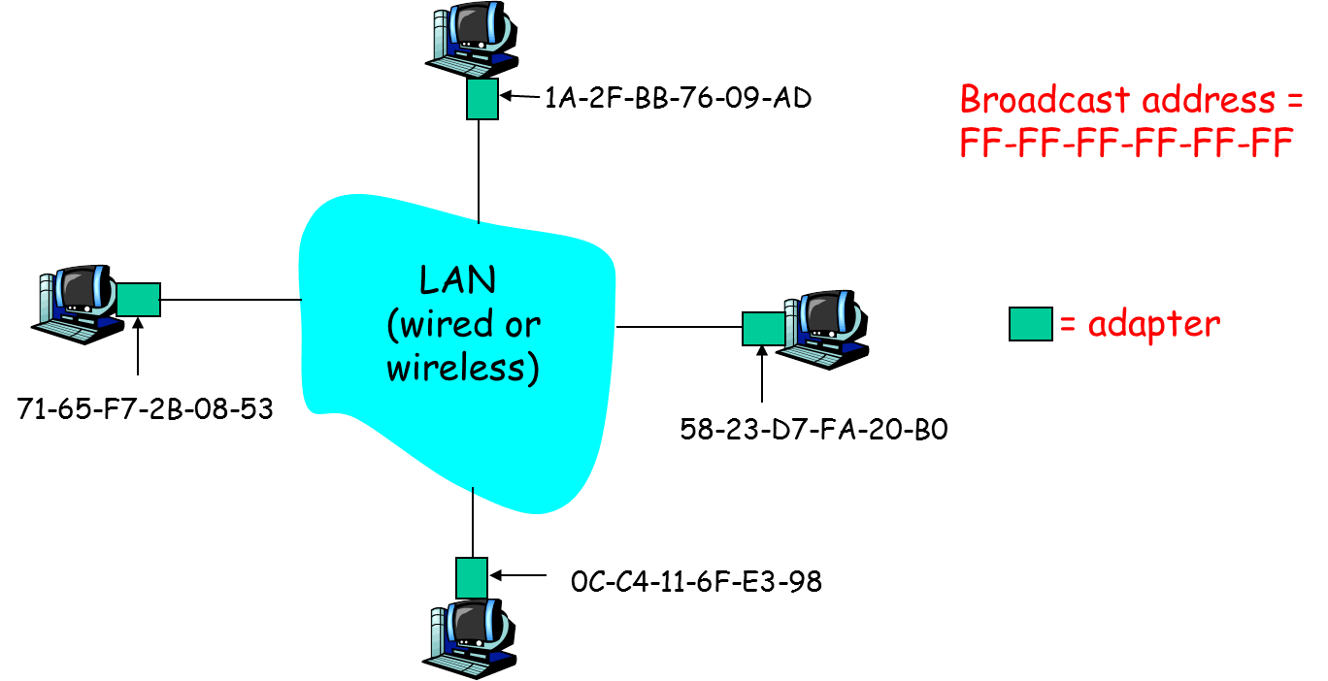
LAN Addresses and ARP
Each adapter on LAN has unique LAN address

Slide 4
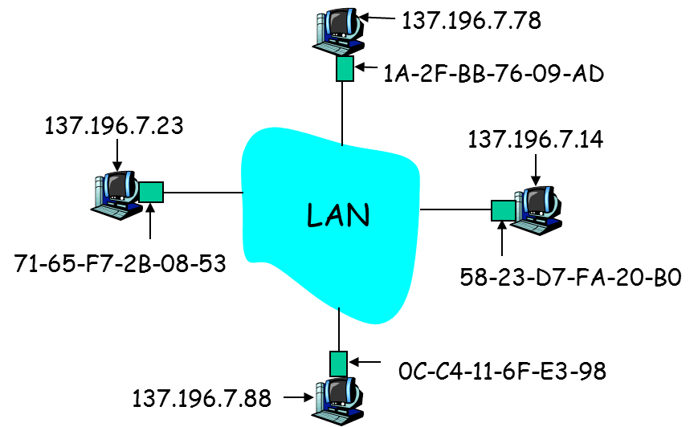
ARP: Address Resolution Protocol
Question: how to determine
MAC address of B
knowing B’s IP address?
Each IP node (host, router) on LAN has ARP table
ARP table: IP/MAC address mappings for some LAN nodes
< IP address; MAC address; TTL>
TTL (Time To Live): time after which address mapping will be forgotten (typically 20 min)

Slide 5
ARP protocol: Same LAN (network)
A wants to send datagram to B, and B’s MAC address not in A’s ARP table.
A broadcasts ARP query packet, containing B's IP address
dest MAC address = FF-FF-FF-FF-FF-FF
all machines on LAN receive ARP query
B receives ARP packet, replies to A with its (B's) MAC address
frame sent to A’s MAC address (unicast)
A caches (saves) IP-to-MAC address pair in its ARP table until information becomes old (times out)
soft state: information that times out (goes away) unless refreshed
ARP is “plug-and-play”:
nodes create their ARP tables without intervention from net administrator

Slide 6
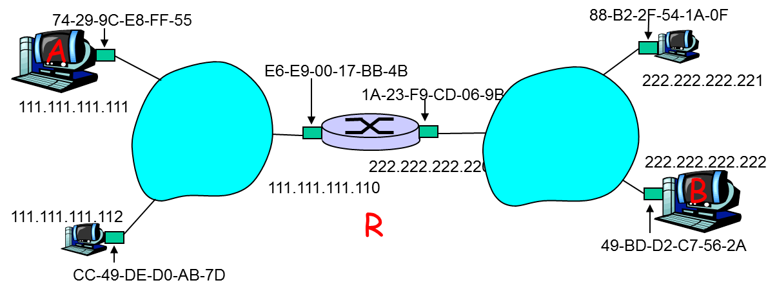
Addressing: routing to another LAN
walkthrough: send datagram from A to B via R
assume A knows B’s IP address
two ARP tables in router R, one for each IP network (LAN)

Slide 7
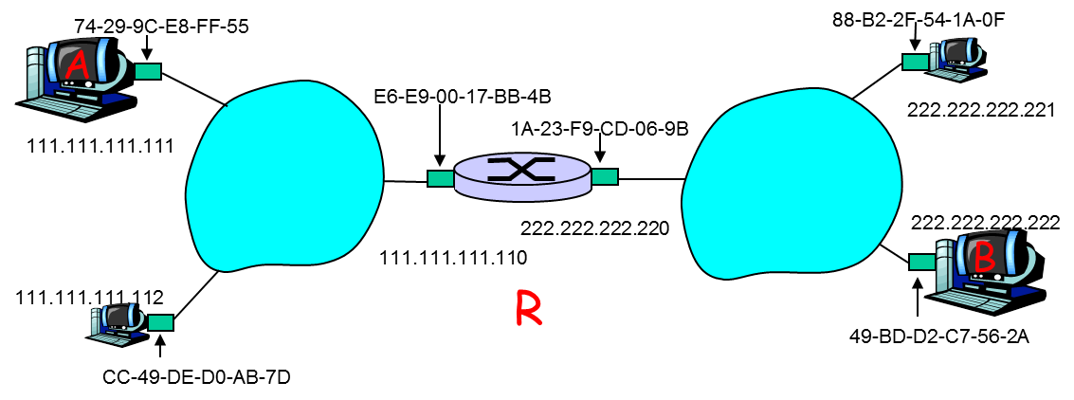
Addressing: routing to another LAN
A creates IP datagram with source A, destination B
A uses ARP to get R’s MAC address for 111.111.111.110
A creates link-layer frame with R's MAC address as dest, frame contains A-to-B IP datagram
A’s NIC sends frame
R’s NIC receives frame
R removes IP datagram from Ethernet frame, sees its destined to B
R uses ARP to get B’s MAC address
R creates frame containing A-to-B IP datagram sends to B
This is a really important example make sure you understand!

Slide 8

Summary
MAC Addresses and ARP

